Slide 1


Slide 2
WHAT THIS DECK COVERS
Agenda
01
About the Analysis
05
Hospital Details
Objectives, scope & dataset snapshot
Drilling into an individual hospital
02
Executive Overview
06
Scenario Insights
Headline KPIs & rating distribution
What-if modeling for improvement
03
Geographic Analysis
07
Key Insights & Recommendations
Performance patterns across states
Turning data into action
04
Performance Measure Details
Mortality, safety & readmissions
HOSPITAL PERFORMANCE & QUALITY ANALYTICS | CAPSTONE PROJECT
02

Slide 3
PROJECT OVERVIEW
Turning Hospital Data into Action
This project analyzes a national hospital general-information dataset covering facility demographics, ownership, and CMS-style quality measures, to help identify where care is strong, where it varies, and where targeted improvement will have the greatest impact.
DATASET SNAPSHOT
5,384
Hospitals nationwide
Understand Performance
6
Hospital types tracked
01
See how hospitals rate overall and by quality domain.
12
Ownership categories
02
Identify Opportunities
Spot where variation signals room to improve.
3
Quality domains — Mortality, Safety, Readmissions
03
Drive Improvement
Model scenarios that raise performance.
Build a Healthier Tomorrow
Fields analyzed include hospital demographics & ownership, emergency-service availability, birthing-friendly designation, overall star rating, and detailed mortality, safety, readmission, patient-experience and timely-care measure counts.
04
Turn insight into patient-centered action.
HOSPITAL PERFORMANCE & QUALITY ANALYTICS | CAPSTONE PROJECT
03

Slide 4
EXECUTIVE OVERVIEW
Headline Performance at a Glance
5,384
3.14 / 5
21.1%
41.4%
Total Hospitals
Average Hospital Rating
High-Performing (≥ 4 ★)
Birthing-Friendly Designated
Hospitals by Overall Rating
WHAT THE DISTRIBUTION SHOWS
Most hospitals cluster in the 3–star band, with 816 facilities — the largest single group.
758 hospitals (14%) already earn 4 stars, and 380 more reach the top 5-star tier.
275 hospitals sit at 1 star, a small but important group for targeted support.
Overall, care quality is solid but uneven — exactly the variation this project set out to quantify.
HOSPITAL PERFORMANCE & QUALITY ANALYTICS | CAPSTONE PROJECT
04

Slide 5
GEOGRAPHIC ANALYSIS
Performance Varies Across States
Top 10 States by Average Hospital Rating
KEY INSIGHTS
•
5,384 hospitals are included in the analysis, spanning every U.S. state and territory.
•
The average hospital rating nationwide is 3.14 out of 5.
•
Utah leads at 4.29, followed by South Dakota at 4.23 — useful performance benchmarks.
•
Hospital distribution and rating levels both vary meaningfully by state.
KEY TAKEAWAYS
•
Higher-rated states can serve as benchmarks for hospital performance.
•
Geographic analysis helps identify disparities in access, resources and quality.
•
Interactive filters (in the live dashboard) enable focused analysis by hospital, state and ownership.
HOSPITAL PERFORMANCE & QUALITY ANALYTICS | CAPSTONE PROJECT
05

Slide 6
PERFORMANCE MEASURE DETAILS
Better, No Different & Worse by Domain
READING THE CHART
Each bar shows the share of measures in a domain where hospitals performed better, no different, or worse than the national benchmark.
Safety
17% of safety measures score better than benchmark — the strongest “better” share of the three domains.
Readmissions
8% of readmission measures score worse — the highest “worse” share, and the clearest improvement target.
Mortality
94% of mortality measures show no significant difference — largely stable, benchmark-level performance.
Higher counts in the “worse” category highlight opportunities for quality improvement.
HOSPITAL PERFORMANCE & QUALITY ANALYTICS | CAPSTONE PROJECT
06

Slide 7
HOSPITAL DETAILS
Drilling Into a Single Hospital
The live dashboard lets a user select any one of the 5,384 hospitals and instantly see its full quality profile alongside national benchmarks.
Selected Hospital
Overall Rating
Hospital Type
State
Search or pick from 5,384 facilities
1–5 star CMS-style rating
Acute Care, Critical Access, Psychiatric …
Geographic context for comparison
Three Domain Charts, Benchmarked Nationally
01
02
03
Mortality (MORT)
Readmissions (READM)
Safety
How the hospital's death-rate measures compare to the national average.
How often patients return within 30 days versus benchmark.
Complication and patient-safety event rates versus benchmark.
HOSPITAL PERFORMANCE & QUALITY ANALYTICS | CAPSTONE PROJECT
07

Slide 8
SCENARIO INSIGHTS
Modeling the Impact of Improvement
Two interactive controls let leadership stress-test improvement plans before committing resources.
01
Rating Threshold
02
Measure Improvement %
Sets the star rating that counts as “high-performing” for the scenario.
Models an across-the-board lift in performance measures.
These drive three live outputs:
Projected High-Performing Hospitals
Projected Safety Performance
Rating vs. Worse Readmissions
Count of hospitals expected to clear the rating threshold under the modeled improvement.
Trend line showing safety measures improving over the scenario.
Scatter of hospital rating against worse-than-expected readmission measures, to spot outliers.
HOSPITAL PERFORMANCE & QUALITY ANALYTICS | CAPSTONE PROJECT
08

Slide 9
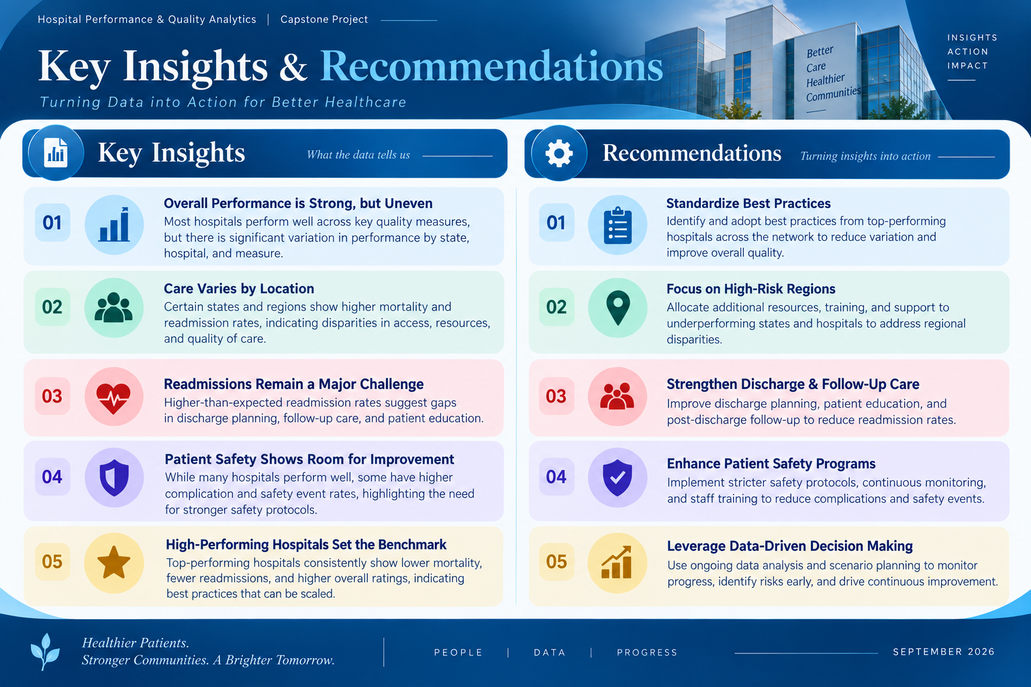

Slide 10
THANK YOU
Data-Driven Hospitals.
Healthier Communities.
PRESENTED BY
Annapoorna Madhu | Anusha Bhagvath | Sajal Srivastava | Srikanth K.
September 2026

